Slide 1


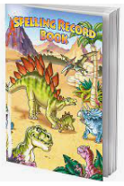
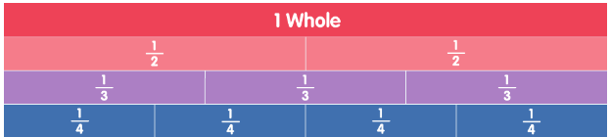
Ellwood Community Primary School – Core Subject Overview Year 2
English | Maths | Science
English Units: We will be focusing our English unit on ‘The Owl who was Afraid of the Dark’. This will lead into our own stories. Grammar: We will be using exclamations, recognizing statements, using statements, recognizing and using the simple past tense,, recognizing and using the past progressive tense and recognizing and using the present progressive tense. | Time Compare and sequence intervals of time. Tell the time; including quarter past/to the hour, o’clock and half past. Draw the hands on a clock face to show these times. Tell and write the time to 5 minute intervals. Know the number of minutes in an hour and the number of hours in a day Fractions Recognise, find, name and write fractions 1/2, 1/4 , 2/4, 1/3 and 3/4 of a length, shape, set of objects or quantity Write simple fractions [e.g. 1/2 of 6 = 3] and recognise the equivalence of 2/4 and 1/2. | Living Things In this unit children will have been introduced to the terms ‘habitat’ (a natural environment or home of a variety of plants and animals) and ‘micro-habitat’ (a very small habitat, for example for woodlice under stones, logs or leaf litter). They will have identified that most living things live in habitats to which they are suited and have described how different habitats provide for the basic needs of different kinds of animals and plants. Children will have explored their immediate local environments.. They will have recognised how differences between places close to each other result in a different range of plants and animals being found. They will have identified and named a variety of plants and animals in their habitats including micro-habitats and have described habitats in terms of their physical conditions.
Spellings:
The spelling rules/patterns we will learn this term are; adding –ing and –ed to cvc and cvcc words, ‘o’ saying /u/, ‘ey’ saying /ee/, Adding –er, -est and –y ro CVCC and CVC words and contractions.

